Slide 1

Movie Recommendation System using MovieLens Data
Brian Lowell

Slide 2
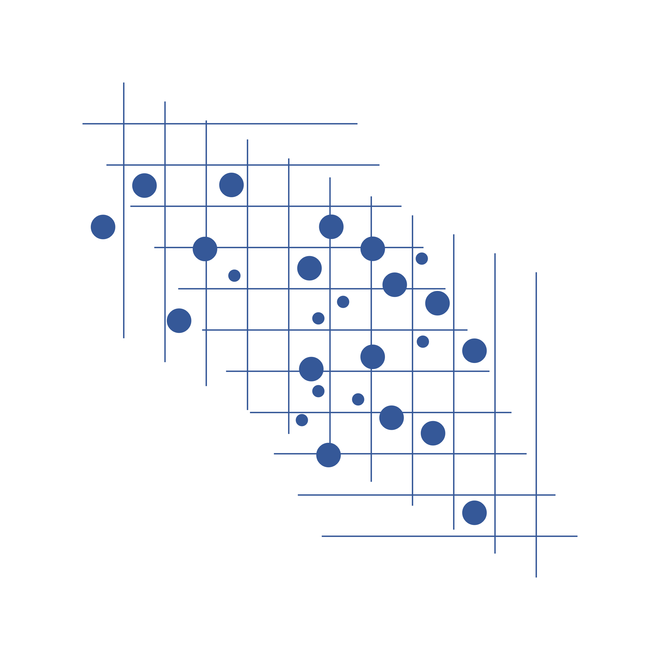
Problem: identifying movies that users will like is challenging
Hypothesis: If a user likes Movie A, they will also like movies similar to Movie A based on taggings and genres.
Solution: Develop a content-based recommender tool to identify similar movies.
Hypothesis: A movie’s rating will be correlated with its features.
Solution: Use regression to predict ratings based on movie features.
Hypothesis: A movie can be recommended based on the preferences of similar users.
Solution: Use matrix factorization and SVD algorithm to predict ratings based on user ratings.

Slide 3
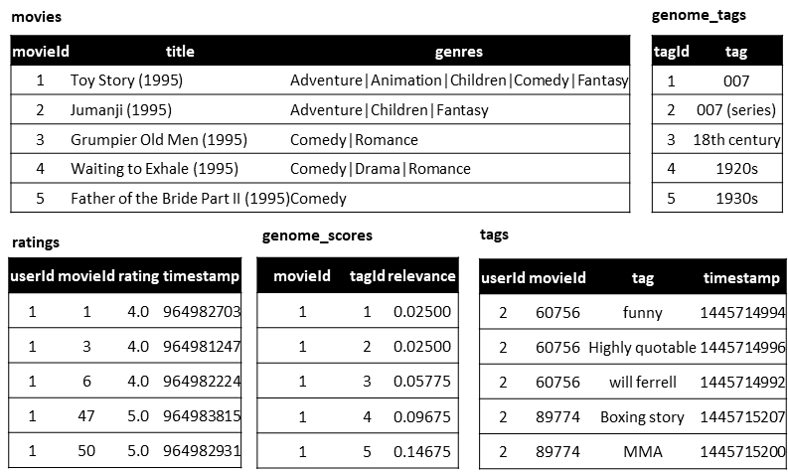
MovieLens 20M Dataset
MovieLens is run by GroupLens, a research lab at the University of Minnesota. By using MovieLens, you will help GroupLens develop new experimental tools and interfaces for data exploration and recommendation. MovieLens is non-commercial, and free of advertisements.
The tag genome encodes how strongly movies exhibit particular properties represented by tags (atmospheric, thought-provoking, realistic, etc.). The tag genome was computed using a machine learning algorithm on user-contributed content including tags, ratings, and textual reviews.
genome_scores: relevancy of a given tag to a movie
genome_tags: tag descriptions and tag_ids
links: includes IMDb and TMDB ids to bring in other data
movies: includes movie id, title (year), and genre tags
ratings: user reviews out of 5
tags: user-generated tags, including user_id, movie_id and tag
Sources: Kaggle, MovieLens.com, Surprise package

Slide 4
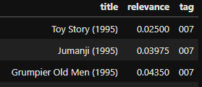
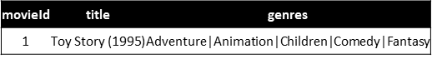
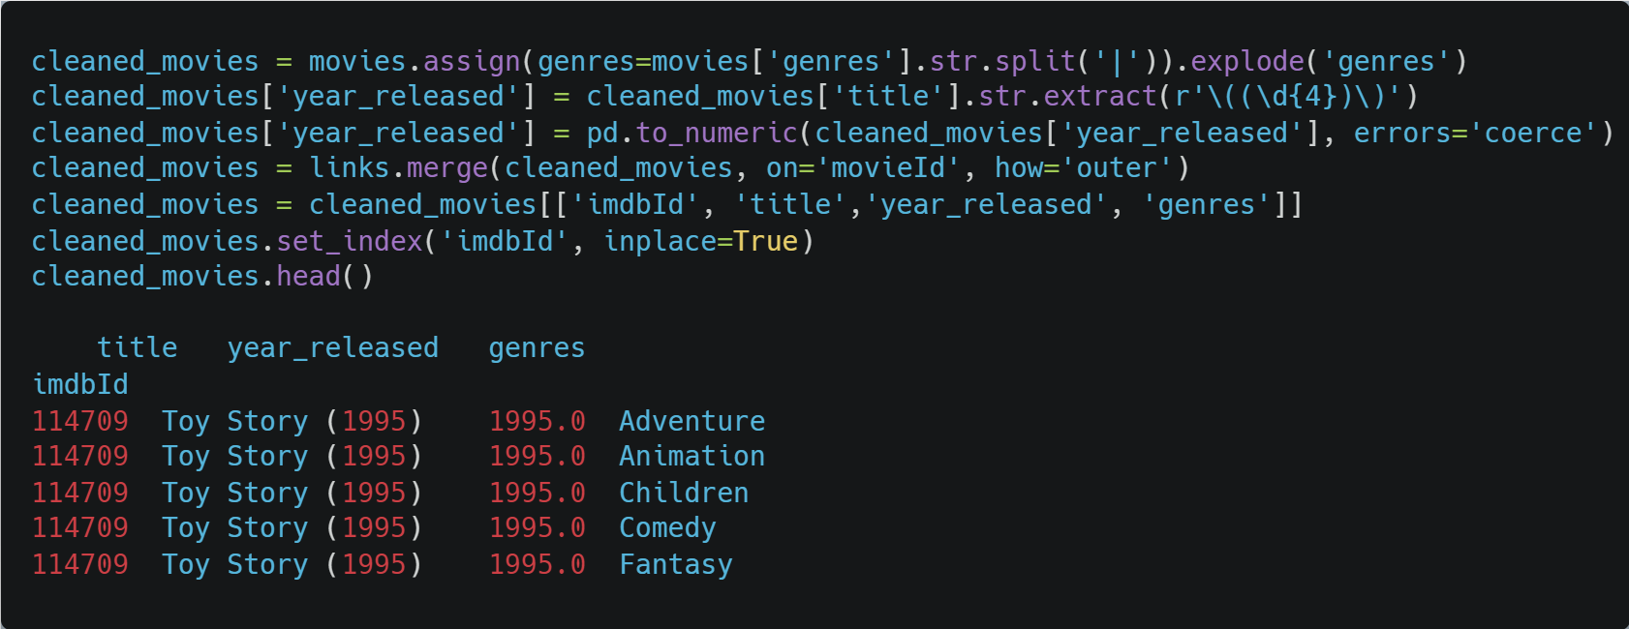
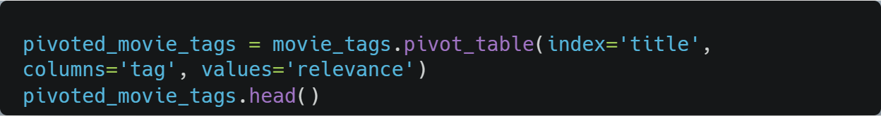
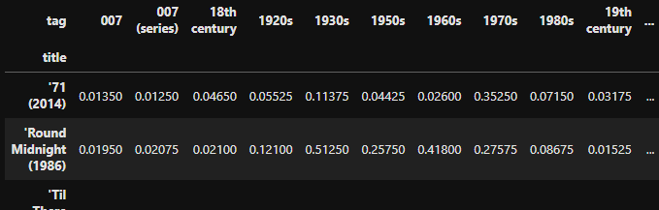
Key Data Challenges & Pre-processing
Problem: genres are pipe-delimited in a single string. They will need to be parsed to use them in a feature matrix.
Problem: tags are included as observations, rather than variables. They will need to be pivoted to combine them into a feature matrix.

Slide 5
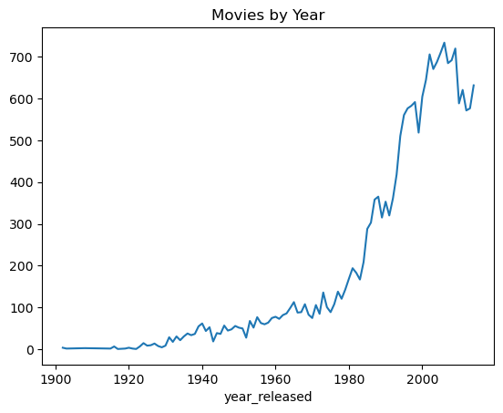
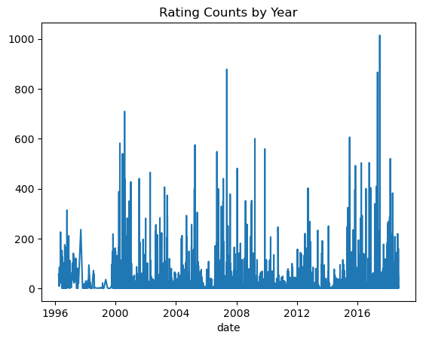
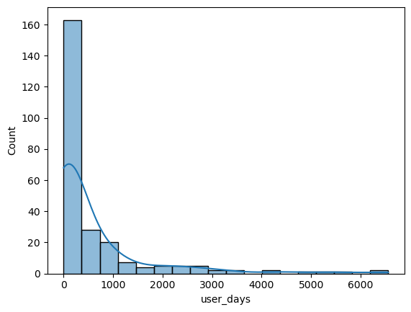
Exploratory Data Analysis
Typical User Lifetime
User Rating Counts
count | 610
mean | 165.30
std | 269.5
min | 20.0
25% | 35
50% | 70.5
75% | 168
max | 2,698

Slide 6

Develop a content-based recommender tool to identify similar movies

Slide 7
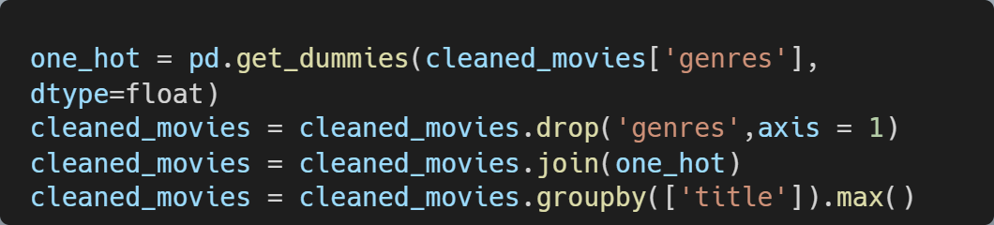
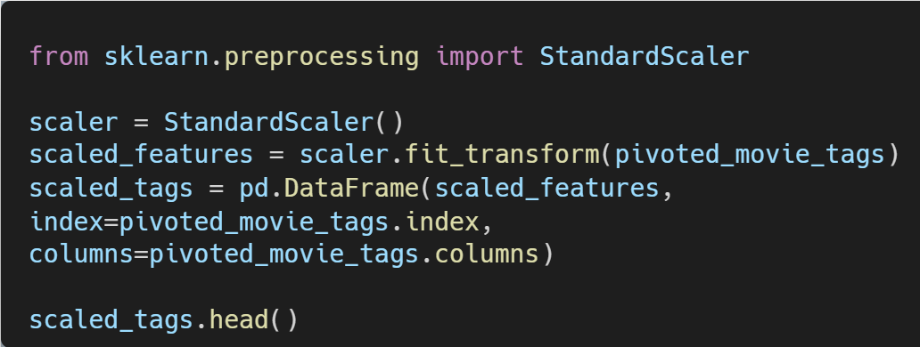
Create feature matrix
one-hot encode genres
merging with scaled tag genome scores
 | year_released | Action | Adventure | Animation | Children | ... | Thriller | War | Western
title
'71 (2014) | 2014.0 | 1.0 | 0.0 | 0.0 | 0.0 | ... | 1.0 | 1.0 | 0.0
'Hellboy': The Seeds of Creation (2004) | 2004.0 | 1.0 | 1.0 | 0.0 | 0.0 | ... | 0.0 | 0.0 | 0.0
'Round Midnight (1986) | 1986.0 | 0.0 | 0.0 | 0.0 | 0.0 | ... | 0.0 | 0.0 | 0.0
'Salem's Lot (2004) | 2004.0 | 0.0 | 0.0 | 0.0 | 0.0 | ... | 1.0 | 0.0 | 0.0
'Til There Was You (1997) | 1997.0 | 0.0 | 0.0 | 0.0 | 0.0 | ... | 0.0 | 0.0 | 0.0
title | Action | Adventure | ... | wwii | zombies
'71 (2014) | 1.0 | 0.0 | ... | 0.340927 | -0.152156
'Hellboy': The Seeds of Creation (2004) | 1.0 | 1.0 | ... | 0.000000 | 0.000000
'Round Midnight (1986) | 0.0 | 0.0 | ... | -0.278982 | -0.167342
'Salem's Lot (2004) | 0.0 | 0.0 | ... | 0.000000 | 0.000000
'Til There Was You (1997) | 0.0 | 0.0 | ... | -0.261763 | -0.161268

Slide 8
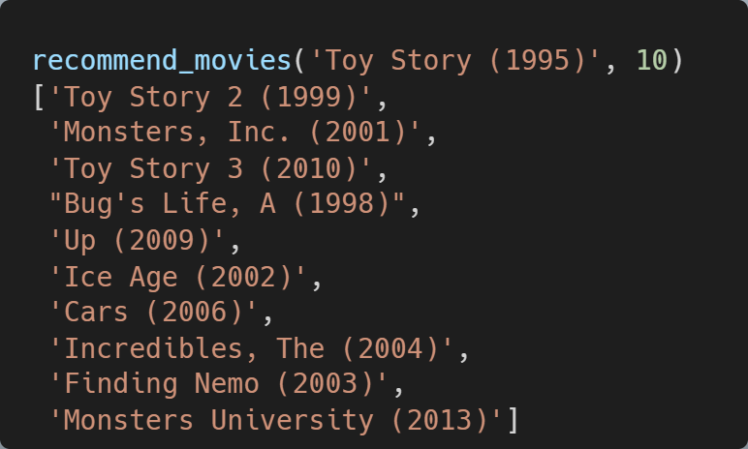
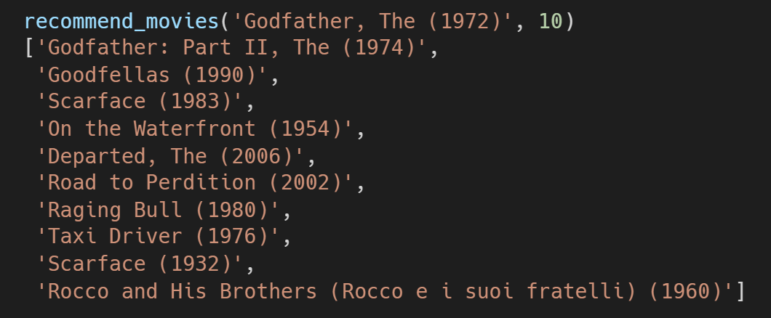
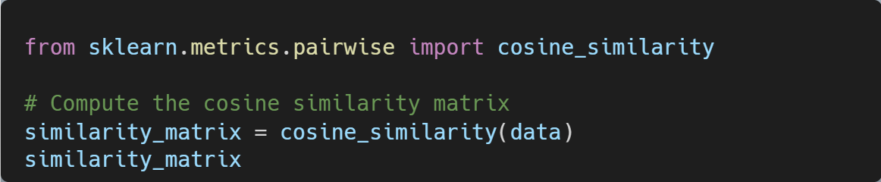
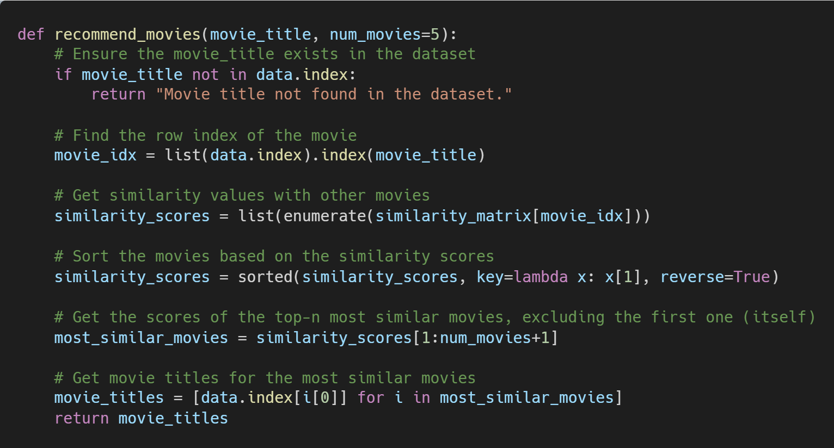
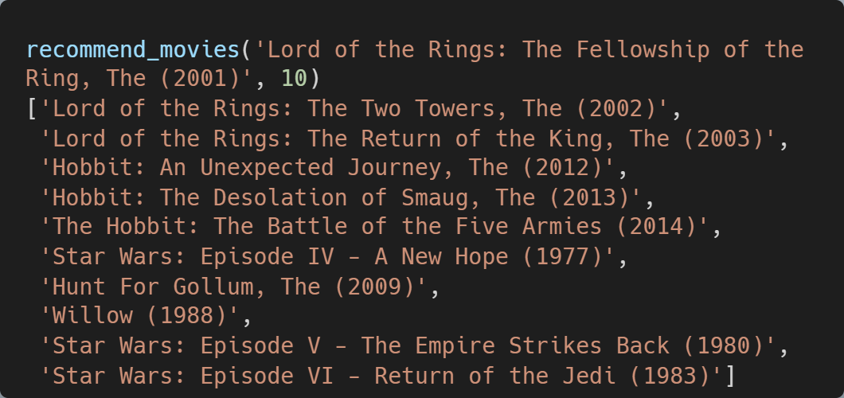
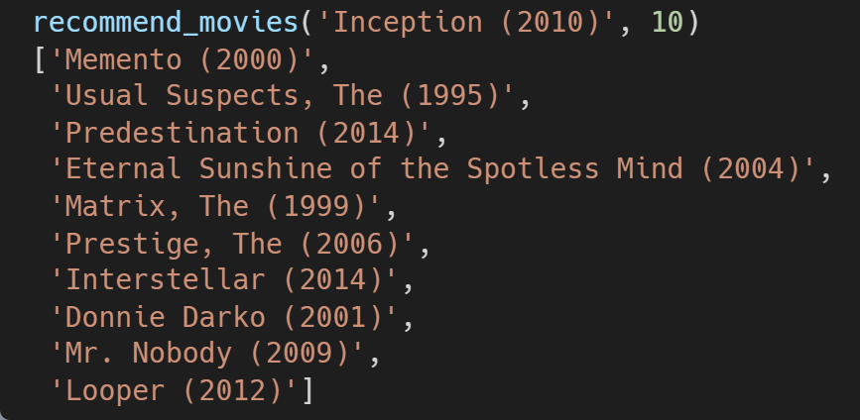
Use cosine similarity matrix to identify similar movies

Slide 9

Using ML models to predict ratings

Slide 10
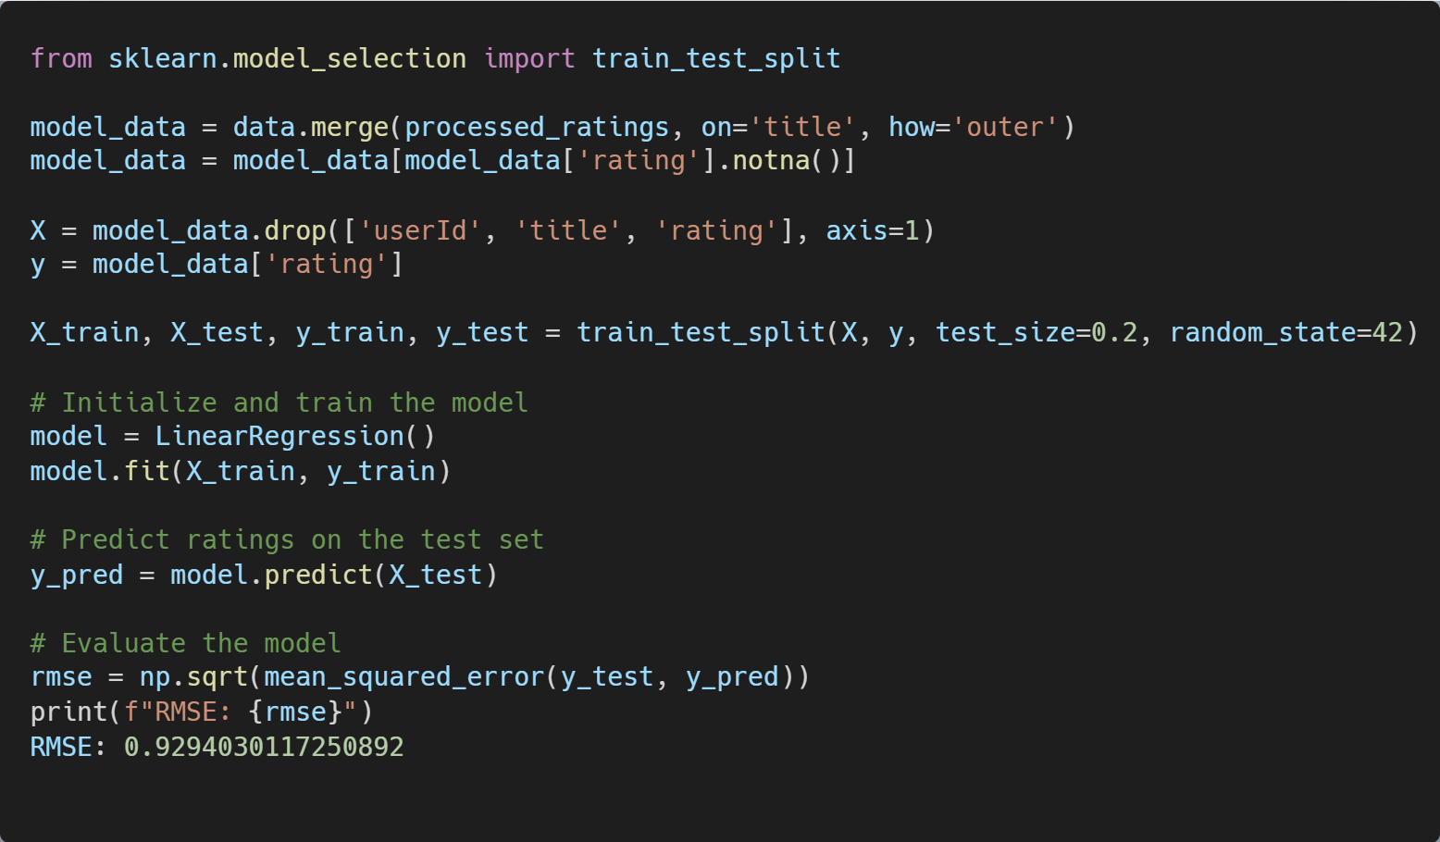
Content-based Filtering Recommendation System
This Linear Regression model aims to predict ratings based solely on a movie’s characteristics. In this implementation, the only features considered are tag scores and genres.
Other features could be used to help improve the accuracy of the model. However, the algorithm does have inherent limitations which make it a less desirable candidate for solving this problem.

Slide 11
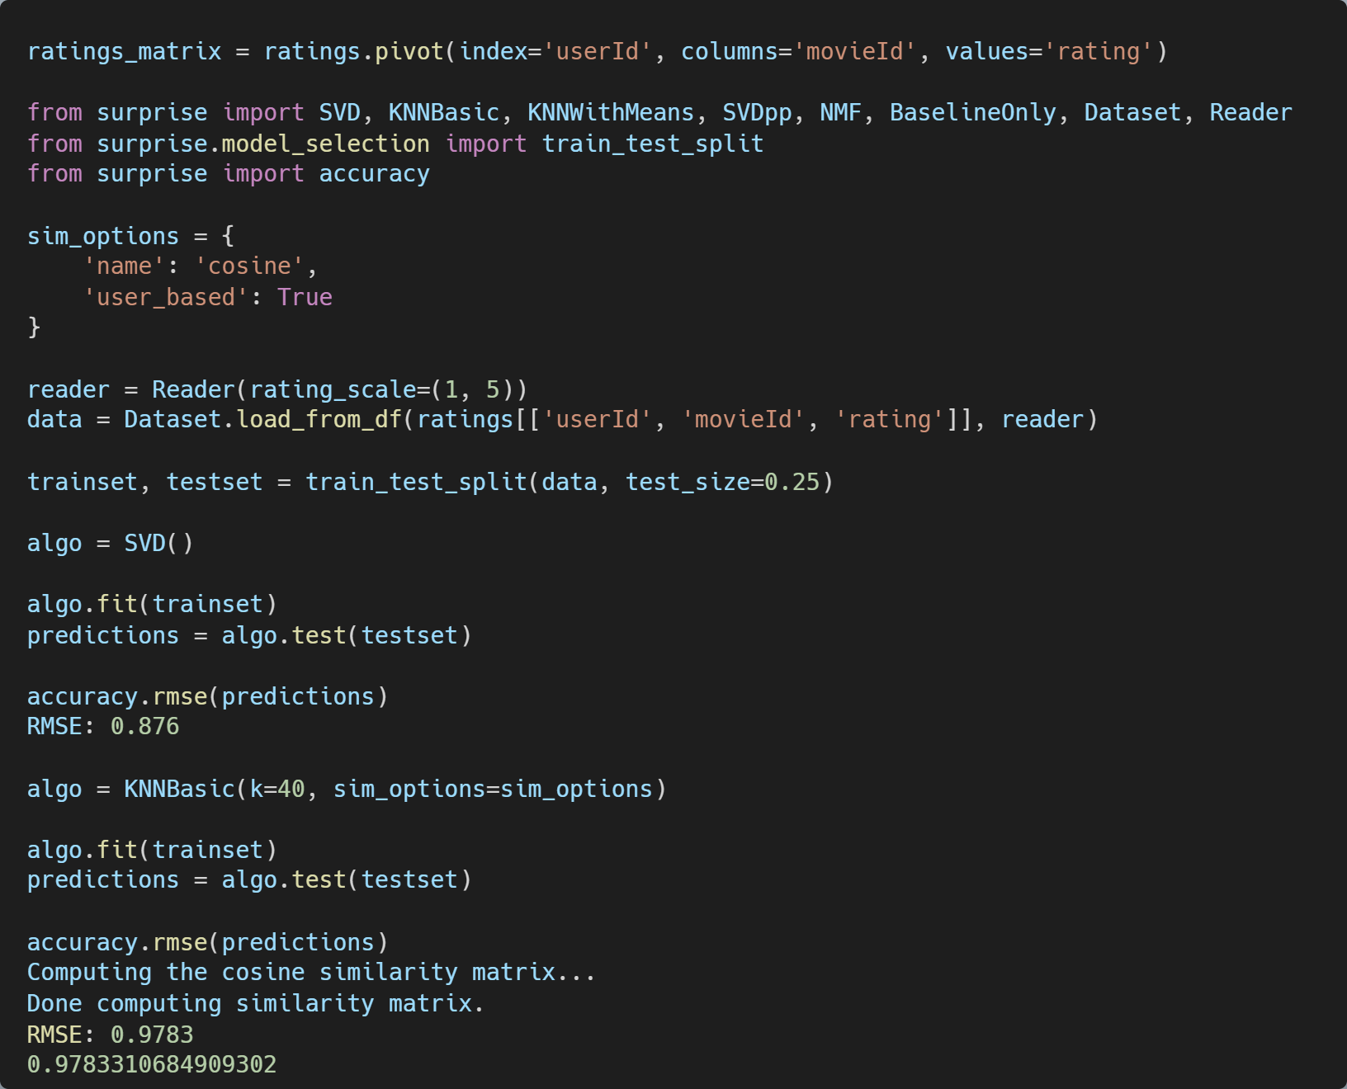
Collaborative Filtering Recommendation System
Collaborative filtering attempts to recommend items based on the preferences of similar users.
Surprise is a Python scikit for building and analyzing recommender systems that deal with explicit rating data.
The first algorithm is the Singular Value Decomposition model, which is a matrix factorization technique. This approach performed the best in terms of minimizing the RMSE.
The second algorithm from this package was the KNN algorithm – this performed a bit worse.

Slide 12
Key Data Challenges & Next Steps
Issue
The dataset is large: ~10,000 movies and 1,100 tags. To feed the feature matrix into a matrix factorization model, more memory and compute is needed.
Genome tags are unprocessed, including very similar tags differentiated by typos or extra text. When put into a feature matrix, this could have the effect of overweighting a tag when calculating similarity
Tags may or may not include principal cast and crew (directors, writers, etc.). These are likely correlated with user preferences but missing from the current feature matrix.
1
2
3

